Slide 1
Networking Technologies
AICT012-4-2 and Version VE3
Network Layer – Basic Router Configurations

Slide 2
Topic & Structure of The Lesson
Topic Title | Topic Objective
Network Layer Characteristics | Explain how the network layer uses IP protocols for reliable communications.
IPv4 Packet | Explain the role of the major header fields in the IPv4 packet.
IPv6 Packet | Explain the role of the major header fields in the IPv6 packet.
How a Host Routes | Explain how network devices use routing tables to direct packets to a destination network.
Introduction to Routing: Router Routing Tables | Explain the function of fields in the routing table of a router.
Configure initial router settings | Configure initial settings on an IOS Cisco Router
Configure interfaces | Configure two active interfaces on an IOS Cisco Router
Configure the default gateway | Configure devices to use the default gateway

Slide 3
Learning Outcomes
At the end of this topic, You should be able to:
Describe the purpose of the network layer in data communication.
Explain why the IPv4 protocol requires other layers to provide reliability.
Explain how a host device uses routing tables to direct packets to itself, a local destination, or a default gateway.
Describe the common components and interfaces of a router.
Describe the boot-up process of a Cisco IOS router
Configure initial settings and interfaces on a Cisco IOS router.
Configure devices to use the default gateway.

Slide 4
Key Terms You Must Be Able To Use
If you have mastered this topic, you should be able to use the following terms correctly in your assignments and exams:
Best effort delivery
Connectionless
Routing
Default gateway
Basic router configuration steps
Configure interfaces
Verify interface configuration
Configure default gateway

Slide 5
7.1 Network Layer Characteristics
Notes:
Cisco Networking Academy Program
Introduction to Networks v6.0
Chapter 8: Network Layer

Slide 6
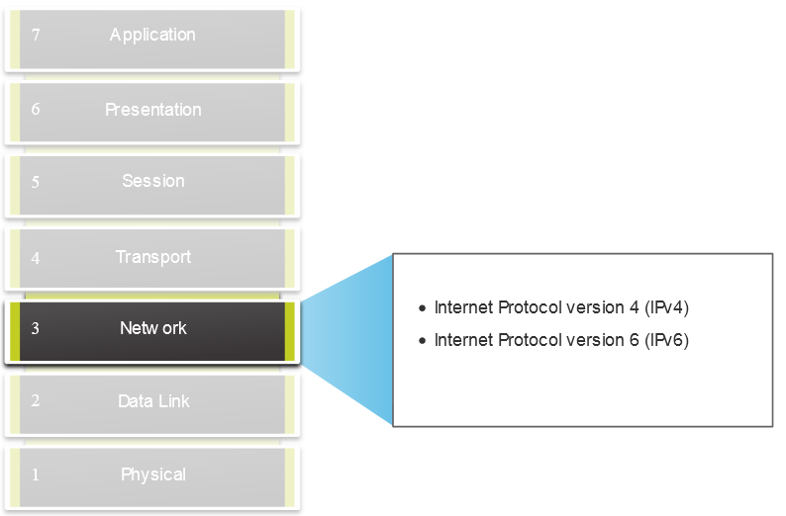
Network Layer Characteristics The Network Layer
Provides services to allow end devices to exchange data
IP version 4 (IPv4) and IP version 6 (IPv6) are the principle network layer communication protocols.
Notes:
8 – Network Layer
8.1 – Network Layer Characteristics
8.1.1 – The Network Layer

Slide 7
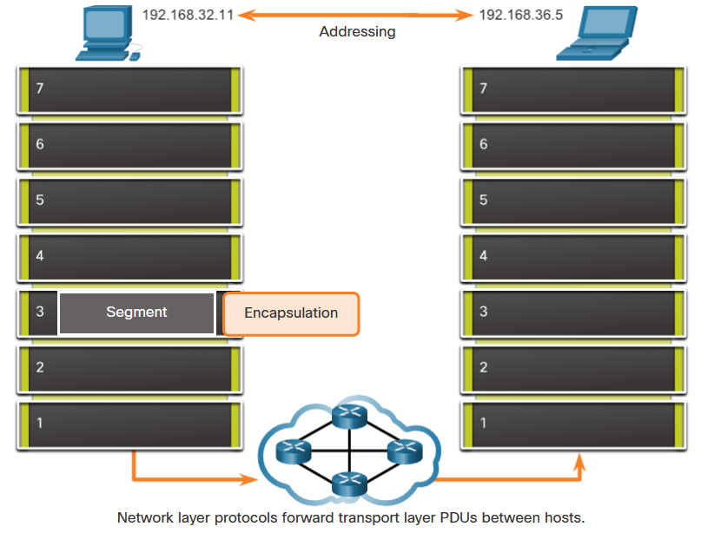
Network Layer Characteristics (Continued) The Network Layer
The network layer performs four basic operations:
Addressing end devices
Encapsulation
Routing
De-encapsulation
Notes:
8 – Network Layer
8.1 – Network Layer Characteristics
8.1.1 – The Network Layer

Slide 8
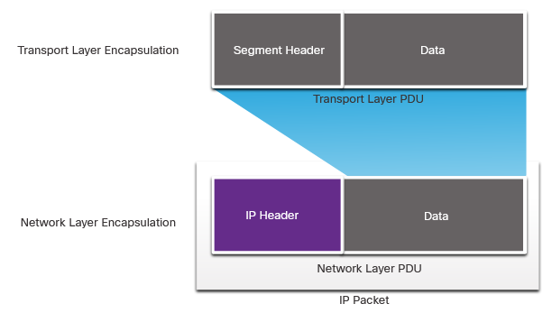
Network Layer Characteristics IP Encapsulation
IP encapsulates the transport layer segment.
IP can use either an IPv4 or IPv6 packet and not impact the layer 4 segment.
IP packet will be examined by all layer 3 devices as it traverses the network.
The IP addressing does not change from source to destination.
Note: NAT will change addressing, but will be discussed in a later module.
Notes:
8 – Network Layer
8.1 – Network Layer Characteristics
8.1.2 – IP Encapsulation

Slide 9
Network Layer Characteristics Characteristic of IP
IP is meant to have low overhead and may be described as:
Connectionless
Best Effort
Media Independent
Notes:
8 – Network Layer
8.1 – Network Layer Characteristics
8.1.3 – Characteristics of IP

Slide 10
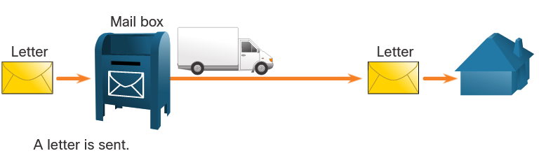
Network Layer Characteristics Connectionless
IP is Connectionless
IP does not establish a connection with the destination before sending the packet.
There is no control information needed (synchronizations, acknowledgments, etc.).
The destination will receive the packet when it arrives, but no pre-notifications are sent by IP.
If there is a need for connection-oriented traffic, then another protocol will handle this (typically TCP at the transport layer).
Notes:
8 – Network Layer
8.1 – Network Layer Characteristics
8.1.4 – Connectionless

Slide 11
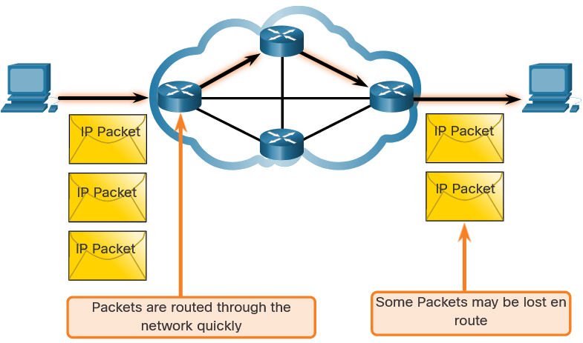
Network Layer Characteristics Best Effort
IP is Best Effort
IP will not guarantee delivery of the packet.
IP has reduced overhead since there is no mechanism to resend data that is not received.
IP does not expect acknowledgments.
IP does not know if the other device is operational or if it received the packet.
Notes:
8 – Network Layer
8.1 – Network Layer Characteristics
8.1.5 – Best Effort

Slide 12
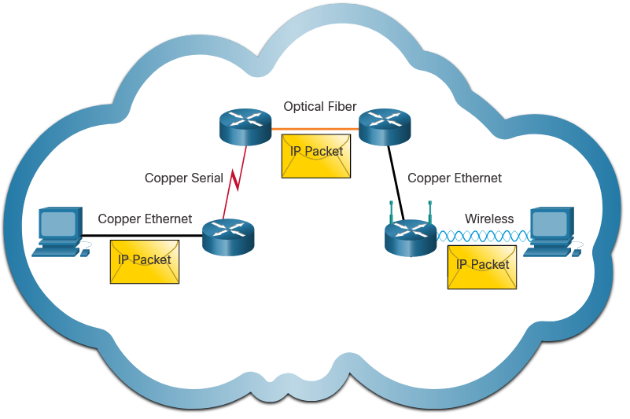
Network Layer Characteristics Media Independent
IP is unreliable:
It cannot manage or fix undelivered or corrupt packets.
IP cannot retransmit after an error.
IP cannot realign out of sequence packets.
IP must rely on other protocols for these functions.
Notes:
8 – Network Layer
8.1 – Network Layer Characteristics
8.1.6 – Media Independent
8.1.7 Check Your Understanding – IP Characteristics

Slide 13
Network Layer Characteristics Media Independent (Continued)
IP is media Independent:
IP does not concern itself with the type of frame required at the data link layer or the media type at the physical layer.
IP can be sent over any media type: copper, fiber, or wireless.
Notes:
8 – Network Layer
8.1 – Network Layer Characteristics
8.1.6 – Media Independent
8.1.7 Check Your Understanding – IP Characteristics

Slide 14
Network Layer Characteristics Media Independent (Continued)
The network layer will establish the Maximum Transmission Unit (MTU).
Network layer receives this from control information sent by the data link layer.
The network then establishes the MTU size.
Notes:
8 – Network Layer
8.1 – Network Layer Characteristics
8.1.6 – Media Independent
8.1.7 Check Your Understanding – IP Characteristics

Slide 15
Network Layer Characteristics Media Independent (Continued)
Fragmentation is when Layer 3 splits the IPv4 packet into smaller units.
Fragmenting causes latency.
IPv6 does not fragment packets.
Example: Router goes from Ethernet to a slow WAN with a smaller MTU
Notes:
8 – Network Layer
8.1 – Network Layer Characteristics
8.1.6 – Media Independent
8.1.7 Check Your Understanding – IP Characteristics

Slide 16
Check your understanding – 7.1 Network Layer/IP Characteristics
Notes:
2 – Basic Switch and End Device Configuration
2.2 – IOS Navigation
2.2.4 – Navigate Between IOS Modes

Slide 17
7.2 IPv4 Packet
Notes:
Cisco Networking Academy Program
Introduction to Networks v6.0
Chapter 8: Network Layer

Slide 18
IPv4 Packet IPv4 Packet Header
IPv4 is the primary communication protocol for the network layer.
The network header has many purposes:
It ensures the packet is sent in the correct direction (to the destination).
It contains information for network layer processing in various fields.
The information in the header is used by all layer 3 devices that handle the packet
Notes:
8 – Network Layer
8.2 – IPv4 Packet
8.2.1 – IPv4 Packet Header

Slide 19
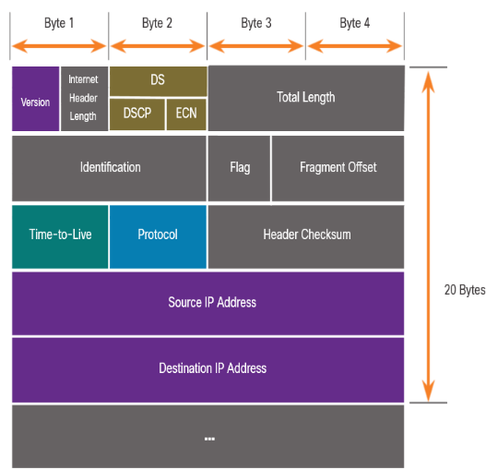
IPv4 Packet IPv4 Packet Header Fields
The IPv4 network header characteristics:
It is in binary.
Contains several fields of information
Diagram is read from left to right, 4 bytes per line
The two most important fields are the source and destination.
Protocols may have may have one or more functions.
Notes:
8 – Network Layer
8.2 – IPv4 Packet
8.2.2 – IPv4 Packet Header Fields

Slide 20
IPv4 Packet IPv4 Packet Header Fields
Significant fields in the IPv4 header:
Function | Description
Version | This will be for v4, as opposed to v6, a 4 bit field= 0100
Differentiated Services | Used for QoS: DiffServ – DS field or the older IntServ – ToS or Type of Service
Header Checksum | Detect corruption in the IPv4 header
Time to Live (TTL) | Layer 3 hop count. When it becomes zero the router will discard the packet.
Protocol | I.D.s next level protocol: ICMP, TCP, UDP, etc.
Source IPv4 Address | 32 bit source address
Destination IPV4 Address | 32 bit destination address
Notes:
8 – Network Layer
8.2 – IPv4 Packet
8.2.2 – IPv4 Packet Header Fields

Slide 21
Check your understanding – 7.2 IPv4 Packet
Notes:
2 – Basic Switch and End Device Configuration
2.2 – IOS Navigation
2.2.4 – Navigate Between IOS Modes

Slide 22
7.3 IPv6 Packet
Notes:
Cisco Networking Academy Program
Introduction to Networks v6.0
Chapter 8: Network Layer

Slide 23
IPv6 Packets Limitations of IPv4
IPv4 has three major limitations:
IPv4 address depletion – We have basically run out of IPv4 addressing.
Lack of end-to-end connectivity – To make IPv4 survive this long, private addressing and NAT were created. This ended direct communications with public addressing.
Increased network complexity – NAT was meant as temporary solution and creates issues on the network as a side effect of manipulating the network headers addressing. NAT causes latency and troubleshooting issues.
Notes:
8 – Network Layer
8.3 – IPv6 Packets
8.3.1 – Limitations of IPv4

Slide 24
IPv6 Packets IPv6 Overview
IPv6 was developed by Internet Engineering Task Force (IETF).
IPv6 overcomes the limitations of IPv4.
Improvements that IPv6 provides:
Increased address space – based on 128 bit address, not 32 bits
Improved packet handling – simplified header with fewer fields
Eliminates the need for NAT – since there is a huge amount of addressing, there is no need to use private addressing internally and be mapped to a shared public address
Notes:
8 – Network Layer
8.3 – IPv6 Packets
8.3.2 – IPv6 Overview

Slide 25
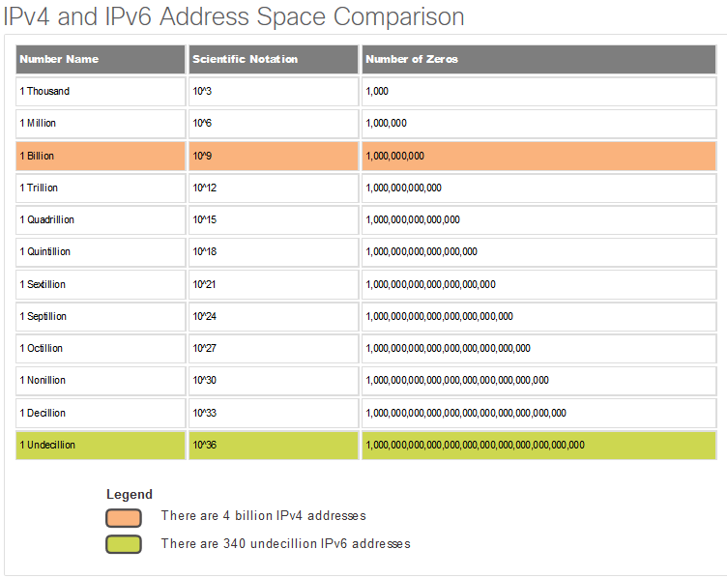
IPv6 Packets IPv6 Overview (Continued)
Notes:
8 – Network Layer
8.3 – IPv6 Packets
8.3.2 – IPv6 Overview

Slide 26
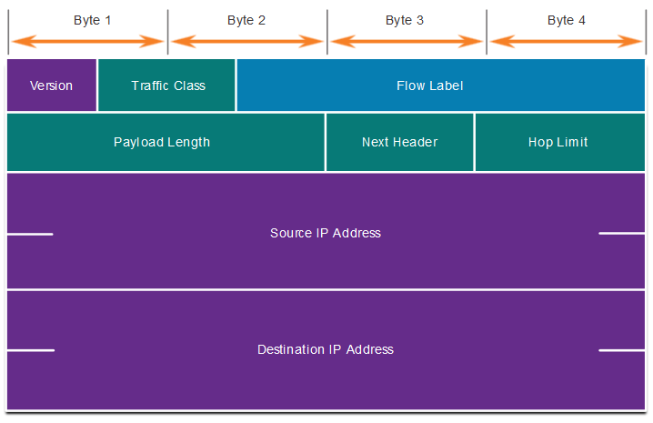
IPv6 Packets IPv4 Packet Header Fields in the IPv6 Packet Header
The IPv6 header is simplified, but not smaller.
The header is fixed at 40 Bytes or octets long.
Several IPv4 fields were removed to improve performance.
Some IPv4 fields were removed to improve performance:
Flag
Fragment Offset
Header Checksum
Notes:
8 – Network Layer
8.3 – IPv6 Packets
8.3.3 – IPv4 Packet Header Fields in the IPv6 Packet Header

Slide 27
IPv6 Packets IPv6 Packet Header
Significant fields in the IPv4 header:
Function | Description
Version | This will be for v6, as opposed to v4, a 4 bit field= 0110
Traffic Class | Used for QoS: Equivalent to DiffServ – DS field
Flow Label | Informs device to handle identical flow labels the same way, 20 bit field
Payload Length | This 16-bit field indicates the length of the data portion or payload of the IPv6 packet
Next Header | I.D.s next level protocol: ICMP, TCP, UDP, etc.
Hop Limit | Replaces TTL field Layer 3 hop count
Source IPv4 Address | 128 bit source address
Destination IPV4 Address | 128 bit destination address
Notes:
8 – Network Layer
8.3 – IPv6 Packets
8.3.4 – IPv6 Packet Header

Slide 28
IPv6 Packets IPv6 Packet Header (Continued)
IPv6 packet may also contain extension headers (EH).
EH headers characteristics:
provide optional network layer information
are optional
are placed between IPv6 header and the payload
may be used for fragmentation, security, mobility support, etc.
Note: Unlike IPv4, routers do not fragment IPv6 packets.
Notes:
8 – Network Layer
8.3 – IPv6 Packets
8.3.4 – IPv6 Packet Header (Cont.)

Slide 29
Check your understanding – 7.3 IPv6 Packet
Notes:
2 – Basic Switch and End Device Configuration
2.2 – IOS Navigation
2.2.4 – Navigate Between IOS Modes

Slide 30
7.4 How a Host Routes
Notes:
Cisco Networking Academy Program
Introduction to Networks v6.0
Chapter 8: Network Layer

Slide 31
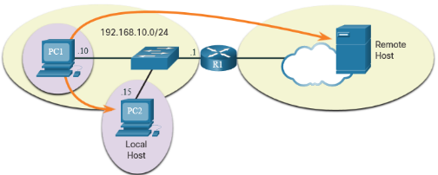
How a Host Routes Host Forwarding Decision
Packets are always created at the source.
Each host devices creates their own routing table.
A host can send packets to the following:
Itself – 127.0.0.1 (IPv4), ::1 (IPv6)
Local Hosts – destination is on the same LAN
Remote Hosts – devices are not on the same LAN
Notes:
8 – Network Layer
8.4 – How a Host Routes
8.4.1 – Host Forwarding Decision

Slide 32

How a Host Routes Host Forwarding Decision (Continued)
The Source device determines whether the destination is local or remote
Method of determination:
IPv4 – Source uses its own IP address and Subnet mask, along with the destination IP address
IPv6 – Source uses the network address and prefix advertised by the local router
Local traffic is dumped out the host interface to be handled by an intermediary device.
Remote traffic is forwarded directly to the default gateway on the LAN.
Notes:
8 – Network Layer
8.4 – How a Host Routes
8.4.1 – Host Forwarding Decision (Cont.)

Slide 33
How a Host Routes Default Gateway
A router or layer 3 switch can be a default-gateway.
Features of a default gateway (DGW):
It must have an IP address in the same range as the rest of the LAN.
It can accept data from the LAN and is capable of forwarding traffic off of the LAN.
It can route to other networks.
If a device has no default gateway or a bad default gateway, its traffic will not be able to leave the LAN.
Notes:
8 – Network Layer
8.4 – How a Host Routes
8.4.2 – Default Gateway

Slide 34
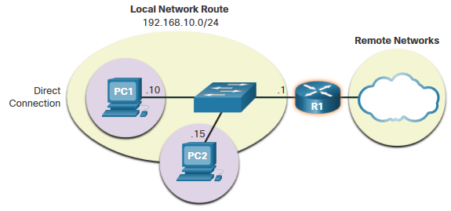
How a Host Routes A Host Routes to the Default Gateway
The host will know the default gateway (DGW) either statically or through DHCP in IPv4.
IPv6 sends the DGW through a router solicitation (RS) or can be configured manually.
A DGW is static route which will be a last resort route in the routing table.
All device on the LAN will need the DGW of the router if they intend to send traffic remotely.
Notes:
8 – Network Layer
8.4 – How a Host Routes
8.4.3 – A Host Routes to the Default Gateway

Slide 35
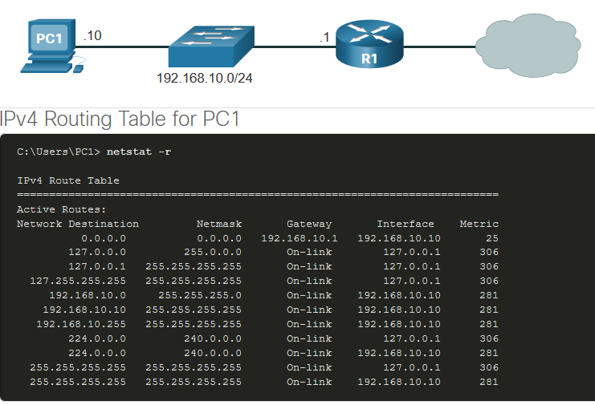
How a Host Routes Host Routing Tables
On Windows, route print or netstat -r to display the PC routing table
Three sections displayed by these two commands:
Interface List – all potential interfaces and MAC addressing
IPv4 Routing Table
IPv6 Routing Table
Notes:
8 – Network Layer
8.4 – How a Host Routes
8.4.4 – Host Routing Tables
8.4.5 – Check Your Understanding – How a Host Routes

Slide 36
Check your understanding – 7.4 How a Host Routes
Notes:
2 – Basic Switch and End Device Configuration
2.2 – IOS Navigation
2.2.4 – Navigate Between IOS Modes

Slide 37
7.5 Introduction to Routing – Router Routing Table
Notes:
Cisco Networking Academy Program
Introduction to Networks v6.0
Chapter 8: Network Layer

Slide 38
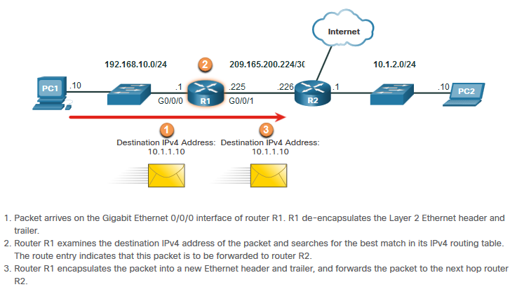
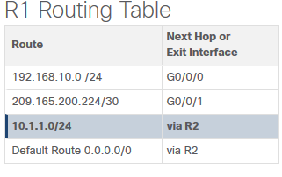
Introduction to Routing Router Packet Forwarding Decision
What happens when the router receives the frame from the host device?
Notes:
8 – Network Layer
8.5 – Introduction to Routing
8.5.1 – Router Packet Forwarding Decision

Slide 39
Introduction to Routing IP Router Routing Table
There three types of routes in a router’s routing table:
Directly Connected – These routes are automatically added by the router, provided the interface is active and has addressing.
Remote – These are the routes the router does not have a direct connection and may be learned:
Manually – with a static route
Dynamically – by using a routing protocol to have the routers share their information with each other
Notes:
8 – Network Layer
8.5 – Introduction to Routing
8.5.2 – IP Router Routing Table

Slide 40
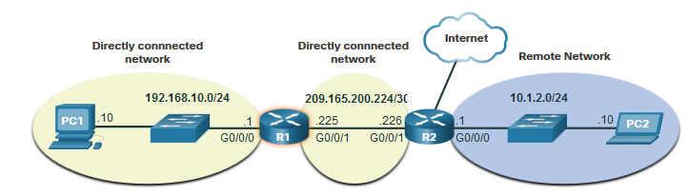
Introduction to Routing IP Router Routing Table (Continued)
Default Route – this forwards all traffic to a specific direction when there is not a match in the routing table
Notes:
8 – Network Layer
8.5 – Introduction to Routing
8.5.2 – IP Router Routing Table

Slide 41
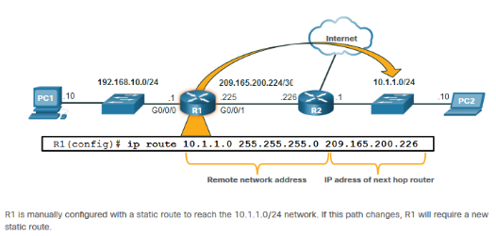
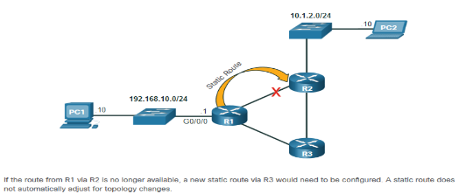
Introduction to Routing Static Routing
Static Route Characteristics:
Must be configured manually
Must be adjusted manually by the administrator when there is a change in the topology
Good for small non-redundant networks
Often used in conjunction with a dynamic routing protocol for configuring a default route
Notes:
8 – Network Layer
8.5 – Introduction to Routing
8.5.3 – Static Routing

Slide 42
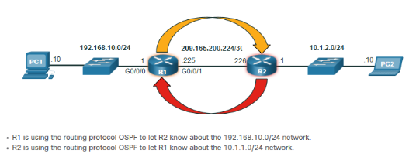
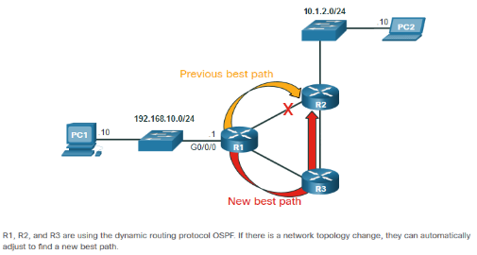
Introduction to Routing Dynamic Routing
Dynamic Routes Automatically:
Discover remote networks
Maintain up-to-date information
Choose the best path to the destination
Find new best paths when there is a topology change
Dynamic routing can also share static default routes with the other routers.
Notes:
8 – Network Layer
8.5 – Introduction to Routing
8.5.4 – Dynamic Routing

Slide 43
Video – IPv4 Router Routing Table
Notes:
2 – Basic Switch and End Device Configuration
2.2 – IOS Navigation
2.2.4 – Navigate Between IOS Modes

Slide 44
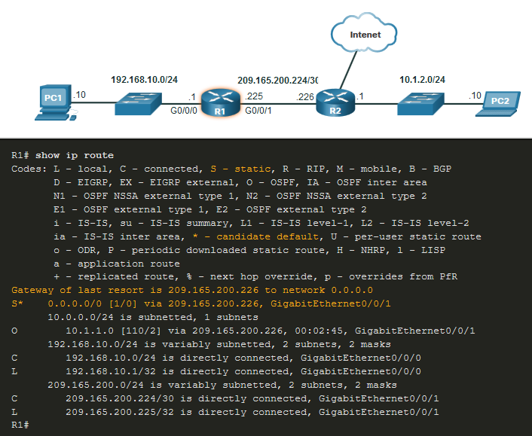
Introduction to Routing Introduction to an IPv4 Routing Table
The show ip route command shows the following route sources:
L - Directly connected local interface IP address
C – Directly connected network
S – Static route was manually configured by an administrator
O – OSPF
D – EIGRP
This command shows types of routes:
Directly Connected – C and L
Remote Routes – O, D, etc.
Default Routes – S*
Notes:
8 – Network Layer
8.5 – Introduction to Routing
8.5.6 – Introduction to an IPv4 Routing Table
8.5.7 – Check Your Understanding – Introduction to Routing

Slide 45
Check your understanding – 7.4 Introduction to Routing – Router Routing Table
Notes:
2 – Basic Switch and End Device Configuration
2.2 – IOS Navigation
2.2.4 – Navigate Between IOS Modes

Slide 46
7.6 Configure Initial Router Settings
Notes:
Cisco Networking Academy Program
Introduction to Networks v6.0
Chapter 10: Basic Router Configuration

Slide 47
Configure Initial Router Settings Basic Router Configuration Steps
Configure the device name.
Secure privileged EXEC mode.
Secure user EXEC mode.
Secure remote Telnet / SSH access.
Router(config)# hostname hostname
Router(config)# enable secret password
Router(config)# line console 0
Router(config-line)# password password
Router(config-line)# login
Router(config)# line vty 0 4
Router(config-line)# password password
Router(config-line)# login
Router(config-line)# transport input {ssh | telnet}
Notes:
10 – Basic Router Configuration
10.1 – Configure Initial Router Settings
10.1.1 – Basic Routing Configuration Steps

Slide 48
Configure Initial Router Settings Basic Router Configuration Steps (Continued)
Encrypt all plaintext passwords.
Provide legal notification and save the configuration.
Router(config)# service password encryption
Router(config)# banner motd # message #
Router(config)# end
Router# copy running-config startup-config
Notes:
10 – Basic Router Configuration
10.1 – Configure Initial Router Settings
10.1.1 – Basic Routing Configuration Steps

Slide 49
Configure Initial Router Settings Basic Router Configuration Example
Commands for basic router configuration on R1.
Configuration is saved to NVRAM.
R1(config)# hostname R1
R1(config)# enable secret class
R1(config)# line console 0
R1(config-line)# password cisco
R1(config-line)# login
R1(config-line)# line vty 0 4
R1(config-line)# password cisco
R1(config-line)# login
R1(config-line)# transport input ssh telnet
R1(config-line)# exit
R1(config)# service password encryption
R1(config)# banner motd #
Enter TEXT message. End with a new line and the #
***********************************************
WARNING: Unauthorized access is prohibited!
**********************************************
R1(config)# exit
R1# copy running-config startup-config
Notes:
10 – Basic Router Configuration
10.1 – Configure Initial Router Settings
10.1.2 – Basic Routing Configuration Example
10.1.3 - Syntax Checker – Configure Initial Router Settings

Slide 50
Activity in Netacad: Syntax Checker - Configure Initial Router Settings
Configure the device name.
Secure the privileged EXEC mode.
Secure and enable remote SSH and Telnet access.
Secure all plaintext passwords.
Provide legal notification.
Notes:
2 – Basic Switch and End Device Configuration
2.2 – IOS Navigation
2.2.4 – Navigate Between IOS Modes

Slide 51
7.7 Configure Interfaces
Notes:
Cisco Networking Academy Program
Introduction to Networks v6.0
Chapter 10: Basic Router Configuration

Slide 52
Configure Interfaces Configure Router Interfaces
Configuring a router interface includes issuing the following commands:
Router(config)# interface type-and-number Router(config-if)# description description-text Router(config-if)# ip address ipv4-address subnet-mask Router(config-if)# ipv6 address ipv6-address/prefix-length Router(config-if)# no shutdown
It is a good practice to use the description command to add information about the network connected to the interface.
The no shutdown command activates the interface.
Notes:
10 – Basic Router Configuration
10.2 – Configure Interfaces
10.2.1 – Configure Router Interfaces

Slide 53
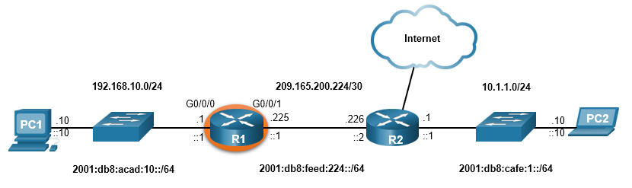
Configure Interfaces Configure Router Interfaces Example
The commands to configure interface G0/0/0 on R1 are shown here:
R1(config)# interface gigabitEthernet 0/0/0
R1(config-if)# description Link to LAN
R1(config-if)# ip address 192.168.10.1 255.255.255.0
R1(config-if)# ipv6 address 2001:db8:acad:10::1/64
R1(config-if)# no shutdown
R1(config-if)# exit
R1(config)#
*Aug 1 01:43:53.435: %LINK-3-UPDOWN: Interface GigabitEthernet0/0/0, changed state to down
*Aug 1 01:43:56.447: %LINK-3-UPDOWN: Interface GigabitEthernet0/0/0, changed state to up
*Aug 1 01:43:57.447: %LINEPROTO-5-UPDOWN: Line protocol on Interface GigabitEthernet0/0/0, changed state to up
Notes:
10 – Basic Router Configuration
10.2 – Configure Interfaces
10.2.2 – Configure Router Interfaces Example

Slide 54
Configure Interfaces Configure Router Interfaces Example (Continued)
The commands to configure interface G0/0/1 on R1 are shown here:
R1(config)# interface gigabitEthernet 0/0/1
R1(config-if)# description Link to R2
R1(config-if)# ip address 209.165.200.225 255.255.255.252
R1(config-if)# ipv6 address 2001:db8:feed:224::1/64
R1(config-if)# no shutdown
R1(config-if)# exit
R1(config)#
*Aug 1 01:46:29.170: %LINK-3-UPDOWN: Interface GigabitEthernet0/0/1, changed state to down
*Aug 1 01:46:32.171: %LINK-3-UPDOWN: Interface GigabitEthernet0/0/1, changed state to up
*Aug 1 01:46:33.171: %LINEPROTO-5-UPDOWN: Line protocol on Interface GigabitEthernet0/0/1, changed state to up
Notes:
10 – Basic Router Configuration
10.2 – Configure Interfaces
10.2.2 – Configure Router Interfaces Example (Cont.)

Slide 55
Configure Interfaces Verify Interface Configuration
To verify interface configuration use the show ip interface brief and show ipv6 interface brief commands shown here:
R1# show ip interface brief
Interface IP-Address OK? Method Status Protocol
GigabitEthernet0/0/0 192.168.10.1 YES manual up up
GigabitEthernet0/0/1 209.165.200.225 YES manual up up
Vlan1 unassigned YES unset administratively down down
R1# show ipv6 interface brief
GigabitEthernet0/0/0 [up/up]
FE80::201:C9FF:FE89:4501
2001:DB8:ACAD:10::1
GigabitEthernet0/0/1 [up/up]
FE80::201:C9FF:FE89:4502
2001:DB8:FEED:224::1
Vlan1 [administratively down/down]
unassigned
R1#
Notes:
10 – Basic Router Configuration
10.2 – Configure Interfaces
10.2.3 – Verify Interface Configuration

Slide 56
Configure Interfaces Configure Verification Commands
The table summarizes show commands used to verify interface configuration.
Commands | Description
show ip interface brief show ipv6 interface brief | Displays all interfaces, their IP addresses, and their current status.
show ip route show ipv6 route | Displays the contents of the IP routing tables stored in RAM.
show interfaces | Displays statistics for all interfaces on the device. Only displays the IPv4 addressing information.
show ip interfaces | Displays the IPv4 statistics for all interfaces on a router.
show ipv6 interfaces | Displays the IPv6 statistics for all interfaces on a router.
Notes:
10 – Basic Router Configuration
10.2 – Configure Interfaces
10.2.4 – Configuration Verification Commands

Slide 57
Configure Interfaces Configure Verification Commands (Continued)
View status of all interfaces with the show ip interface brief and show ipv6 interface brief commands, shown here:
R1# show ip interface brief
Interface IP-Address OK? Method Status Protocol
GigabitEthernet0/0/0 192.168.10.1 YES manual up up
GigabitEthernet0/0/1 209.165.200.225 YES manual up up
Vlan1 unassigned YES unset administratively down down
R1#
R1# show ipv6 interface brief
GigabitEthernet0/0/0 [up/up]
FE80::201:C9FF:FE89:4501
2001:DB8:ACAD:10::1
GigabitEthernet0/0/1 [up/up]
FE80::201:C9FF:FE89:4502
2001:DB8:FEED:224::1
Vlan1 [administratively down/down]
unassigned
R1#
Notes:
10 – Basic Router Configuration
10.2 – Configure Interfaces
10.2.4 – Configuration Verification Commands (Cont.)

Slide 58
Configure Interfaces Configure Verification Commands (Continued)
Display the contents of the IP routing tables with the show ip route and show ipv6 route commands as shown here:
R1# show ip route
< output omitted>
Gateway of last resort is not set
192.168.10.0/24 is variably subnetted, 2 subnets, 2 masks
C 192.168.10.0/24 is directly connected, GigabitEthernet0/0/0
L 192.168.10.1/32 is directly connected, GigabitEthernet0/0/0
209.165.200.0/24 is variably subnetted, 2 subnets, 2 masks
C 209.165.200.224/30 is directly connected, GigabitEthernet0/0/1
L 209.165.200.225/32 is directly connected, GigabitEthernet0/0/1
R1#
R1# show ipv6 route
<output omitted>
C 2001:DB8:ACAD:10::/64 [0/0]
via GigabitEthernet0/0/0, directly connected
L 2001:DB8:ACAD:10::1/128 [0/0]
via GigabitEthernet0/0/0, receive
C 2001:DB8:FEED:224::/64 [0/0]
via GigabitEthernet0/0/1, directly connected
L 2001:DB8:FEED:224::1/128 [0/0]
via GigabitEthernet0/0/1, receive
L FF00::/8 [0/0]
via Null0, receive
R1#
Notes:
10 – Basic Router Configuration
10.2 – Configure Interfaces
10.2.4 – Configuration Verification Commands (Cont.)

Slide 59
Configure Interfaces Configure Verification Commands (Cont.)
Display statistics for all interfaces with the show interfaces command, as shown here:
R1# show interfaces gig0/0/0
GigabitEthernet0/0/0 is up, line protocol is up
Hardware is ISR4321-2x1GE, address is a0e0.af0d.e140 (bia a0e0.af0d.e140)
Description: Link to LAN
Internet address is 192.168.10.1/24
MTU 1500 bytes, BW 100000 Kbit/sec, DLY 100 usec,
reliability 255/255, txload 1/255, rxload 1/255
Encapsulation ARPA, loopback not set
Keepalive not supported
Full Duplex, 100Mbps, link type is auto, media type is RJ45
output flow-control is off, input flow-control is off
ARP type: ARPA, ARP Timeout 04:00:00
Last input 00:00:01, output 00:00:35, output hang never
Last clearing of "show interface" counters never
Input queue: 0/375/0/0 (size/max/drops/flushes); Total output drops: 0
Queueing strategy: fifo
Output queue: 0/40 (size/max)
5 minute input rate 0 bits/sec, 0 packets/sec
5 minute output rate 0 bits/sec, 0 packets/sec
1180 packets input, 109486 bytes, 0 no buffer
Received 84 broadcasts (0 IP multicasts)
0 runts, 0 giants, 0 throttles
<output omitted>
R1#
Notes:
10 – Basic Router Configuration
10.2 – Configure Interfaces
10.2.4 – Configuration Verification Commands (Cont.)

Slide 60
Configure Interfaces Configure Verification Commands (Continued)
Display IPv4 statistics for router interfaces with the show ip interface command, as shown here:
R1# show ip interface g0/0/0
GigabitEthernet0/0/0 is up, line protocol is up
Internet address is 192.168.10.1/24
Broadcast address is 255.255.255.255
Address determined by setup command
MTU is 1500 bytes
Helper address is not set
Directed broadcast forwarding is disabled
Outgoing Common access list is not set
Outgoing access list is not set
Inbound Common access list is not set
Inbound access list is not set
Proxy ARP is enabled
Local Proxy ARP is disabled
Security level is default
Split horizon is enabled
ICMP redirects are always sent
ICMP unreachables are always sent
ICMP mask replies are never sent
IP fast switching is enabled
IP Flow switching is disabled
<output omitted>
R1#
Notes:
10 – Basic Router Configuration
10.2 – Configure Interfaces
10.2.4 – Configuration Verification Commands (Cont.)

Slide 61
Configure Interfaces Configure Verification Commands (Continued)
Display IPv6 statistics for router interfaces with the show ipv6 interface command shown here:
R1# show ipv6 interface g0/0/0
GigabitEthernet0/0/0 is up, line protocol is up
IPv6 is enabled, link-local address is FE80::868A:8DFF:FE44:49B0
No Virtual link-local address(es):
Description: Link to LAN
Global unicast address(es):
2001:DB8:ACAD:10::1, subnet is 2001:DB8:ACAD:10::/64
Joined group address(es):
FF02::1
FF02::1:FF00:1
FF02::1:FF44:49B0
MTU is 1500 bytes
ICMP error messages limited to one every 100 milliseconds
ICMP redirects are enabled
ICMP unreachables are sent
ND DAD is enabled, number of DAD attempts: 1
ND reachable time is 30000 milliseconds (using 30000)
ND NS retransmit interval is 1000 milliseconds
R1#
Notes:
10 – Basic Router Configuration
10.2 – Configure Interfaces
10.2.4 – Configuration Verification Commands (Cont.)
10.2.5 Syntax Checker – Configure Interfaces

Slide 62
Activity in Netacad: Syntax Checker - Configure Interfaces
Describe the link as 'Link to LAN'.
Configure the IPv4 address as 192.168.10.1 with the subnet mask 255.255.255.0.
Configure the IPv6 address as 2001:db8:acad:10::1 with the /64 prefix length.
Activate the interface.
Notes:
2 – Basic Switch and End Device Configuration
2.2 – IOS Navigation
2.2.4 – Navigate Between IOS Modes

Slide 63
7.8 Configure the Default Gateway
Notes:
Cisco Networking Academy Program
Introduction to Networks v6.0
Chapter 10: Basic Router Configuration

Slide 64
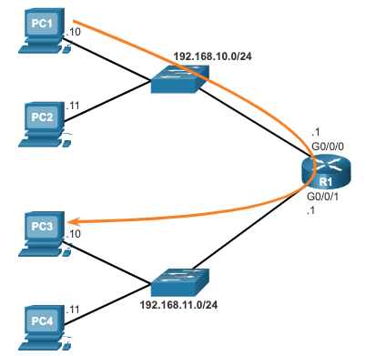
Configure the Default Gateway Default Gateway on a Host
The default gateway is used when a host sends a packet to a device on another network.
The default gateway address is generally the router interface address attached to the local network of the host.
To reach PC3, PC1 addresses a packet with the IPv4 address of PC3, but forwards the packet to its default gateway, the G0/0/0 interface of R1.
Note: The IP address of the host and the router interface must be in the same network.
Notes:
10 – Basic Router Configuration
10.3 – Configure the Default Gateway
10.3.1 – Default Gateway on a Host

Slide 65
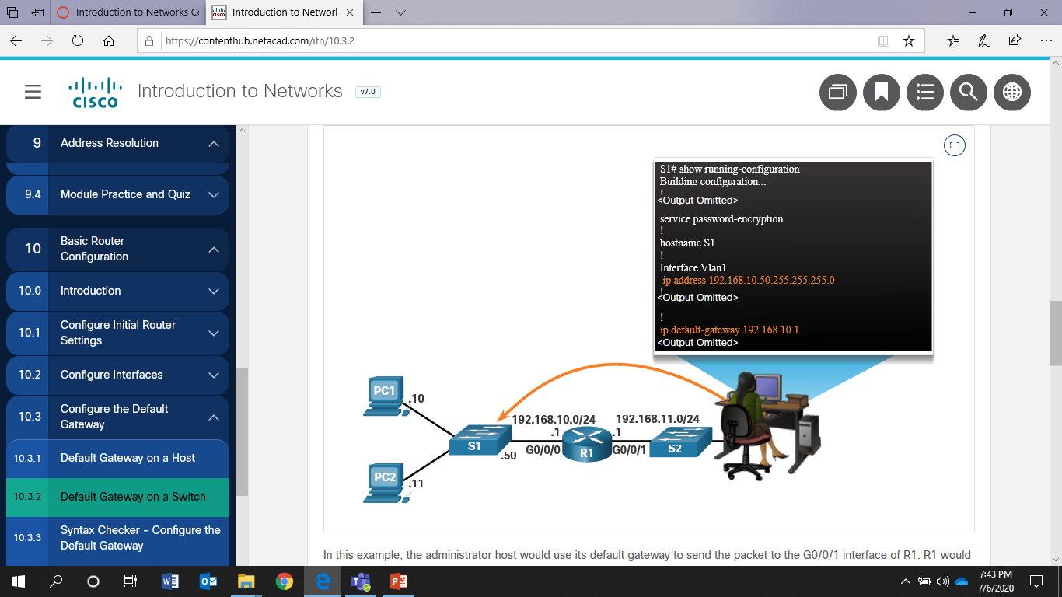
Configure the Default Gateway Default Gateway on a Switch
A switch must have a default gateway address configured to remotely manage the switch from another network.
To configure an IPv4 default gateway on a switch, use the ip default-gateway ip-address global configuration command.
Notes:
10 – Basic Router Configuration
10.3 – Configure the Default Gateway
10.3.2 – Default Gateway on a Switch
10.3.3 – Syntax Checker – Configure the Default Gateway

Slide 66
Activity in Netacad: Syntax Checker - Configure the Default Gateway
To practice configuring the default gateway of a Layer 2 switch
Notes:
2 – Basic Switch and End Device Configuration
2.2 – IOS Navigation
2.2.4 – Navigate Between IOS Modes

Slide 67
Quick Review Question
Refer to Quiz - Chapter 8 and 10 in Cisco Networking Academy platform

Slide 68
Summary of Main Teaching Points
Explain how routers enable end-to-end connectivity in a small to medium-sized business network.
Explain how devices route traffic in a small to medium-sized business network.
IP is connectionless, best effort, and media independent.
IP does not guarantee packet delivery.
IPv4 packet header consists of fields containing information about the packet.
IPv6 overcomes IPv4 lack of end-to-end connectivity and increased network complexity.
A device will determine if a destination is itself, another local host, and a remote host.

Slide 69
Summary of Main Teaching Points
A default gateway is router that is part of the LAN and will be used as a door to other networks.
The routing table contains a list of all known network addresses (prefixes) and where to forward the packet.
The router uses longest subnet mask or prefix match.
The routing table has three types of route entries: directly connected networks, remote networks, and a default route.
Configure a router with basic configurations.
Configure interfaces
Verify interface configuration
Configure verification commands
Configure default gateway (host and switch)

Slide 70
Question and Answer Session
Q & A

Slide 71
What we will cover next
IP Addressing – IPv4

Slide 72


Slide 73


